Slide 1
Garbage Surveillance Robot
Project by :
Aashirwad N. B. (01FB14EEE004)
Kavin Nishanth (01FB14EEE034)
Koustav Mandal (01FB14EEE038)
Guide: Dr. M. J. Venkatarangan

Slide 2
Problem Statement
To search for garbage sites in a location (for example, the PES campus) and alert the house-keeping authorities.

Slide 3
WHAT TO EXPECT
A mobile robot which can:
1. Learn and repeat a path of the user’s choice
2. Capture images of the path’s surroundings and identify garbage
3. Alert the user of its findings

Slide 4
METHODOLOGY
Study phase
Chalk down the high level requirements for the project map them to corresponding technical specifications
Study papers/references dealing with the similar topics and summarize the contents relevant to the project
List down the test cases to test the working of the robot
Design phase
Based on the technical specifications and other constraints, select the software, electrical and mechanical architecture for the robot
Gain familiarity with the architecture involved

Slide 5
Design the algorithms to be used (for the path repeating and image classifying problems)
Identify the various subsystems involved in the project
3. Implementation phase
Obtain the necessary hardware
Split the work of implementing the different subsystems among members of the team
Implement each of the subsystems involved
Test the algorithms on a pre-built robot
Integrate the subsystems and implement the algorithms on the designed robot

Slide 6
4. System Testing phase
Observe the operation of the robot in the aforementioned test cases
Make corrections/modifications to the system as required
5. Field Testing phase
Test the working of the robot under different simulated and real world conditions

Slide 7
Progress
1. Listed down speed and time requirements
2. Calculated the battery requirement
3. Literature survey of 3 papers was completed
4. Gained familiarity in Python (used in OpenCV)

Slide 8
Speed Requirements
User requirement:
1. Should
Survey a distance of 200m in about 15 min
Complete at least 4 round-trips before being recharged
Technical requirement:
Distance between the two points = 200m
Assuming it stops every 1.5m to capture an image of its surroundings and takes 5s to capture and process the image, the time taken to traverse the path = 4 min
Or an average speed of approximately 80 cm/s

Slide 9
Battery requirement
Estimating the total robot weight
4 DC motors with gearboxes = 4 * 180 gm = 720 gm
4 wheels + chassis = 370 gm
Total battery weight = 250 gm
Raspberry Pi + Auxiliary weight = 45 + 100 gm
Total = 1.5 kg
With an angle of inclination = 30 and rolling friction coefficient = 0.05
Force = 8.5 N or 9 N
Motor Power = 9 W
Raspberry pi consumption = approx 6 W
Total power = 15 W
Battery voltage = 12 V (typical motor rating)
Battery capacity = at least 30WH (15W * 120 minutes) or 2500mAH

Slide 10
Literature Survey
Lidar-based Teach-and-Repeat of Mobile Robot Trajectories by Sprunk, Tripadi, et al
User taught trajectories is represented by anchor points - raw odometry and 2d laser data (no camera)
Scan matching to estimate the offset of the robot position from anchor points
Algorithm calculates error in the configuration space, which is then used in feedback

Slide 11
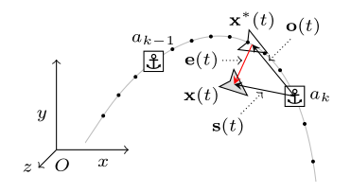

s(t) is estimated by comparing laser scans
Given the offset to the current
anchor, we can determine the offset
to the next few anchor
points and switch to the closest one.
Feedback equation. The gain matrix is chosen to be positive definite so that the error reduces to 0 eventually

Slide 12
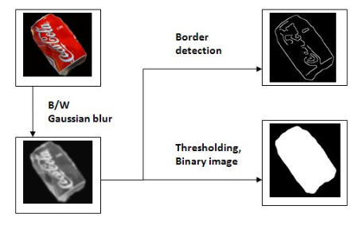
Image processing of garbage
Garbage is mainly metal, glass, plastic and paper
TWO important methods:-
1. Segmentation
Border detection – discontinuties in surface orientation
Thresholding to isolate background and eliminate noise
Gaussian blur to soften the details and noise
Conversion from color to black and white and binary image

Slide 13
2.Thresolding Using OTSU algorithm
Seperate the pixels into two clusters according to the threshold.
Find the mean of the each clusters
Square the difference between the means
Multiply by the no. of pixels in one cluster times the no. in the other.
Histogram
Graph showing the number of pixels in an image at each different intensity value .
Thresholding
Replace image with black and white pixel whose intensity will lesser & greater than Constant

Slide 14
BLOCK DIAGRAM (Tentative)
Power supply
Ultrasonic sensor
Voltage regulator
Raspberry PI 3
Motor Drive
4 Motors
Wheel encoder
Raspberry pi Camera
module

Slide 15
APPEARANCE-BASED LIDAR
Appearance-based lidar technique, which involves three main steps: (i) image formation, where the raw lidar data are processed
into a stack of intensity,range images (ii) keypoint generation, to create metric keypoints for motion estimation, and (iii) our back-end
estimation framework. .
(i) image formation : Due to the fact that most objects in a natural environment are not very reflective, the raw intensity image is extremely dark and requires
image processing for use in a feature detector.Here we use a linear range correction (i.e., multiplying the intensity values by their associated range) and rescaling
the brightness values into the [0, 255]

Slide 16
(ii) keypoint generation : Using a GPU implementation of the SURF algorithm, keypoint detection in the intensity image, returns a list
of image locations, yi = [ui vi]. In computer vision, speeded up robust features (SURF) is a patented local feature detector and descriptor.
It can be used for tasks such as object recognition, image registration, classification or 3D reconstruction.
(iii) Bundle Adjustment : We use the keypoints generated from our image stack to compute the reprojection error, which is the standard error term in bundle adjustment.
In each control cycle, the system performs frame-to-frame VO to update its estimate in the map and then matches against the closest keyframe in the map.

Slide 17
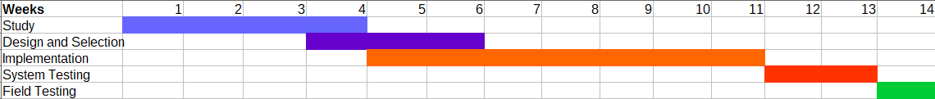
Timeline of project

Slide 18
Goals for the next few weeks
Week 1. Study more papers related to the problems
Week 2. Conclude study, select the hardware and software for the project, obtain a Raspberry Pi
Week 3. Design the algorithms required and identify
The subsystems involved in the project (motor drivers, wireless communications, etc.) and divide the work among the team
Week 4. Implement some of the subsystems on a prebuilt
Robot

Slide 19
References
Lidar-based Teach-and-Repeat of Mobile Robot Trajectories, Sprunk et al
Visual Teach and Repeat for Long-Range Rover Autonomy, Paul Furgale and Timothy D. Barfoot
Intelligent Garbage Classifier, Alvaro Salmador, Javier Pérez Cid, Ignacio Rodríguez Novelle
An ICP variant using a point-to-line metric, Andrea Censi

Slide 20
THANK YOU

